Slide 1

CSC120 LAB – COMPUTER PROGRAMMING 1
WEEKLY LAB
Everett

Slide 2

WEEK 4 – LAB 3
CSC120
LAB
Monday 2/10/2025
Comparison
Lab Instructor:
Dr. Hien Nguyen

Slide 3
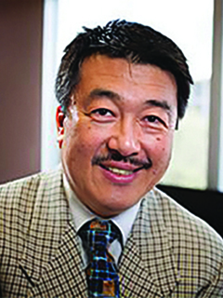
CSC120 Lecture Professor
Dr. Mitsunori Ogihara
Professor
Office: Ungar Building, Room 310F
E-mail: mogihara@miami.edu
Office Hours: T
https://people.miami.edu/profile/9930bd3ea82f8adb34c87a31680b79c4

Slide 4

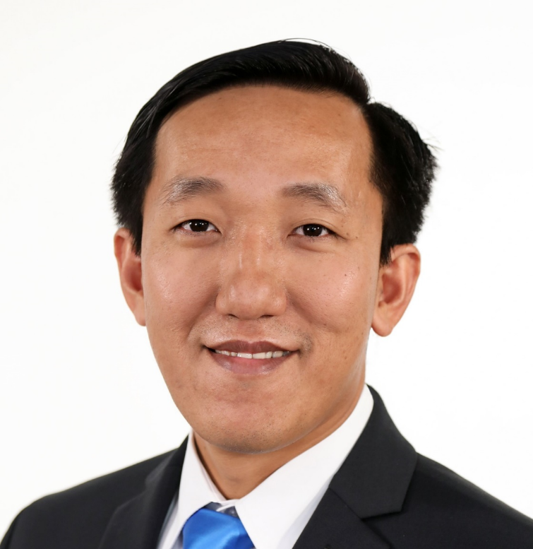
LAB Instructor & TAs
Dr. Hien Nguyen
Lecturer
Office: Ungar Building, Room 310E
E-mail: HMN35@miami.edu
Office Hours: Monday from 7am – 8:00am
Tuesday from 10am – 12:00pm,
Thursday from 10am – 12pm,
or by appointment
Teaching Assistants & their office hours at Ungar Building, room 310T
Martineulr Decastro Marasigan : Thursday from 11am – 1pm
Esteban Isaac Morales : Thursday from 2pm – 3pm
Everett Xu: Wednesday from 11am – 4pm
Fakhir Ahmed Aslam : Tuesday from 1pm – 2pm

Slide 5
TODAY’S LAB

Slide 6
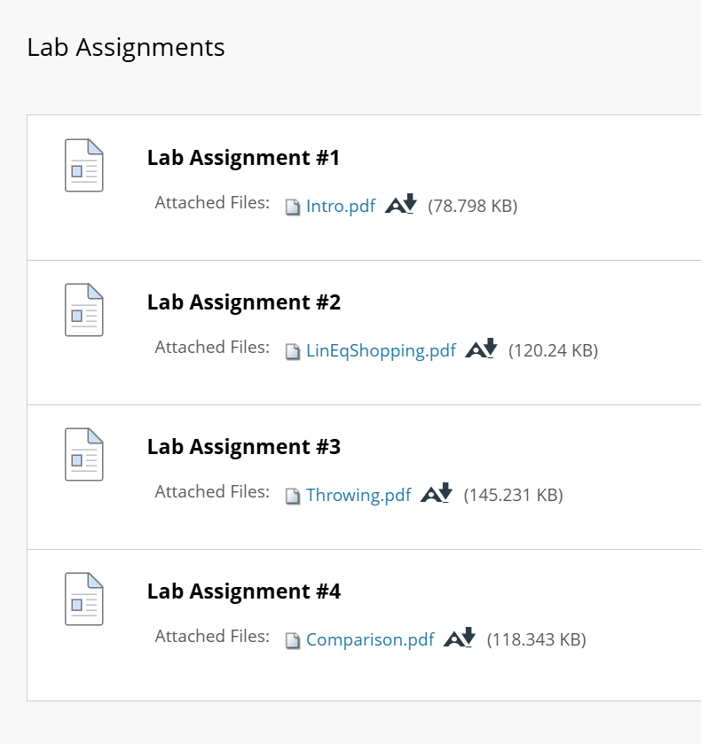

TODAY’S LAB

Slide 7
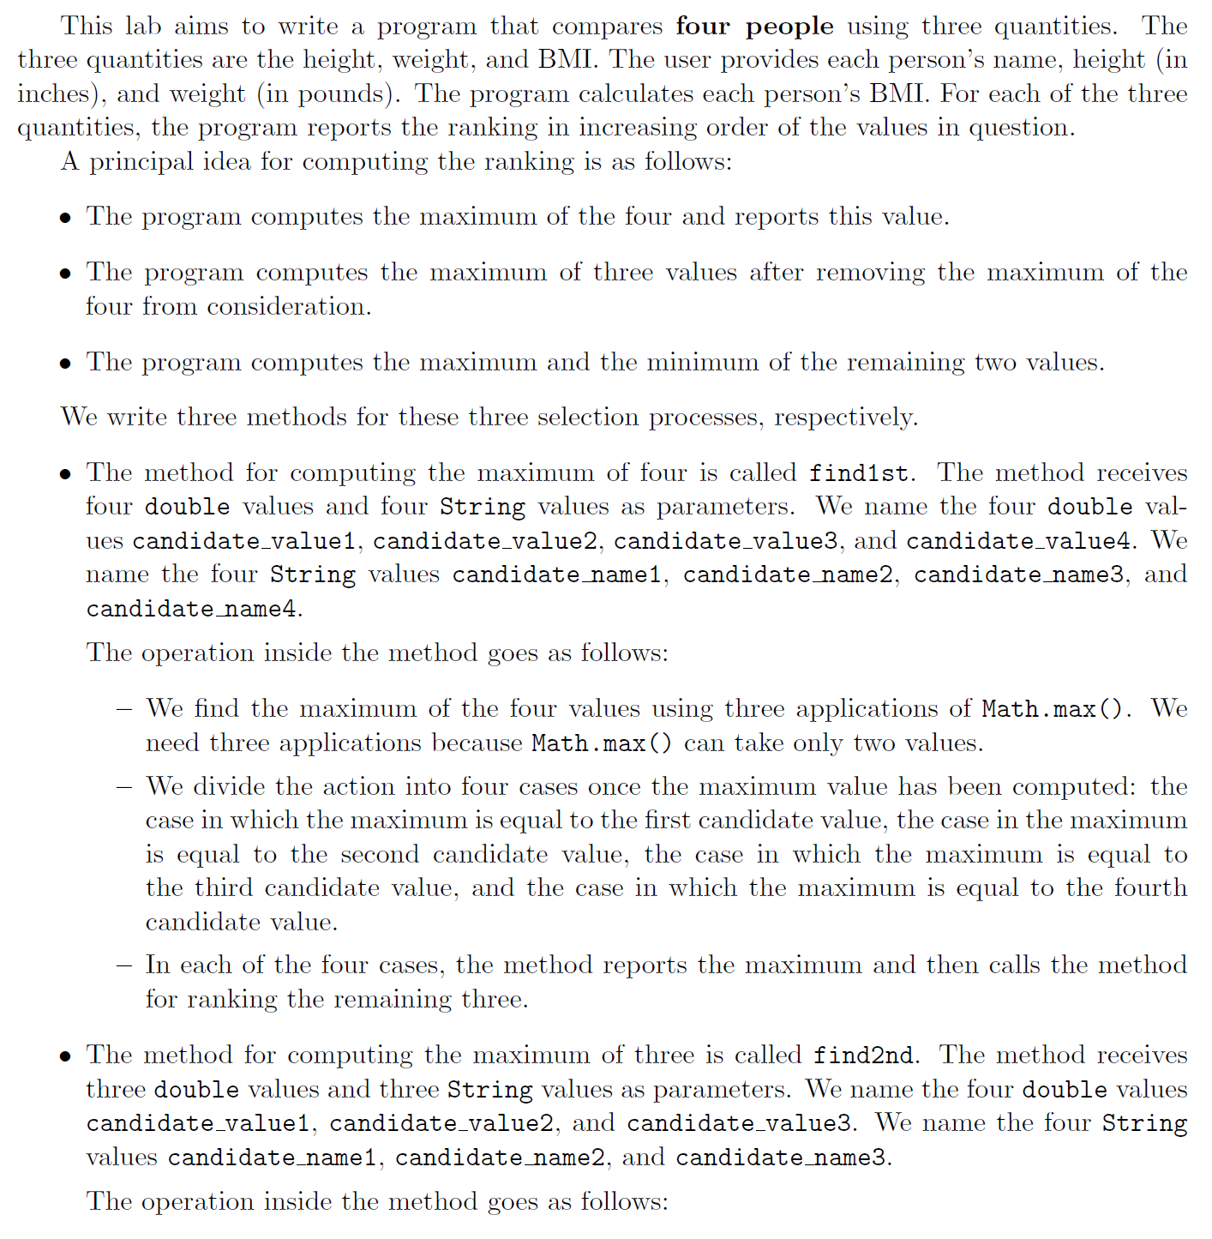
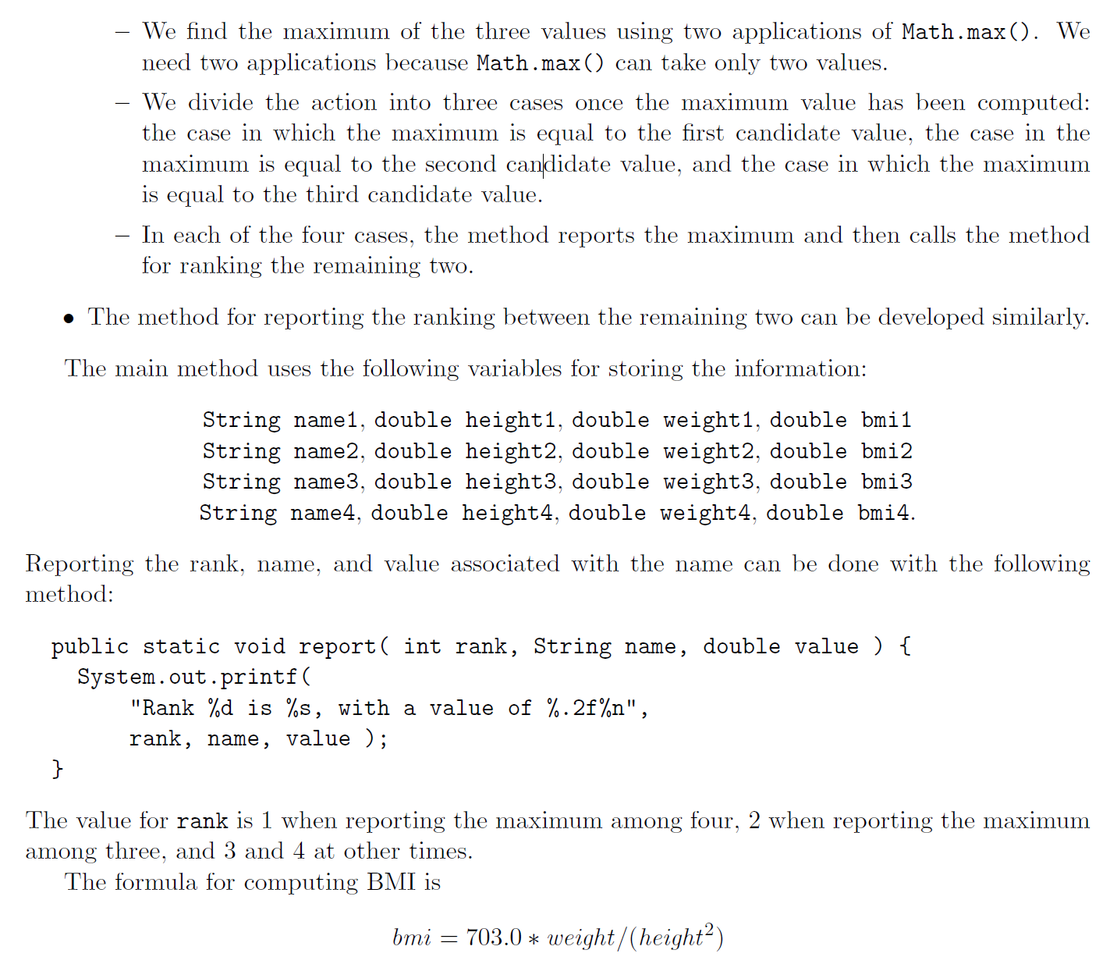
LAB4 - Comparison

Slide 8
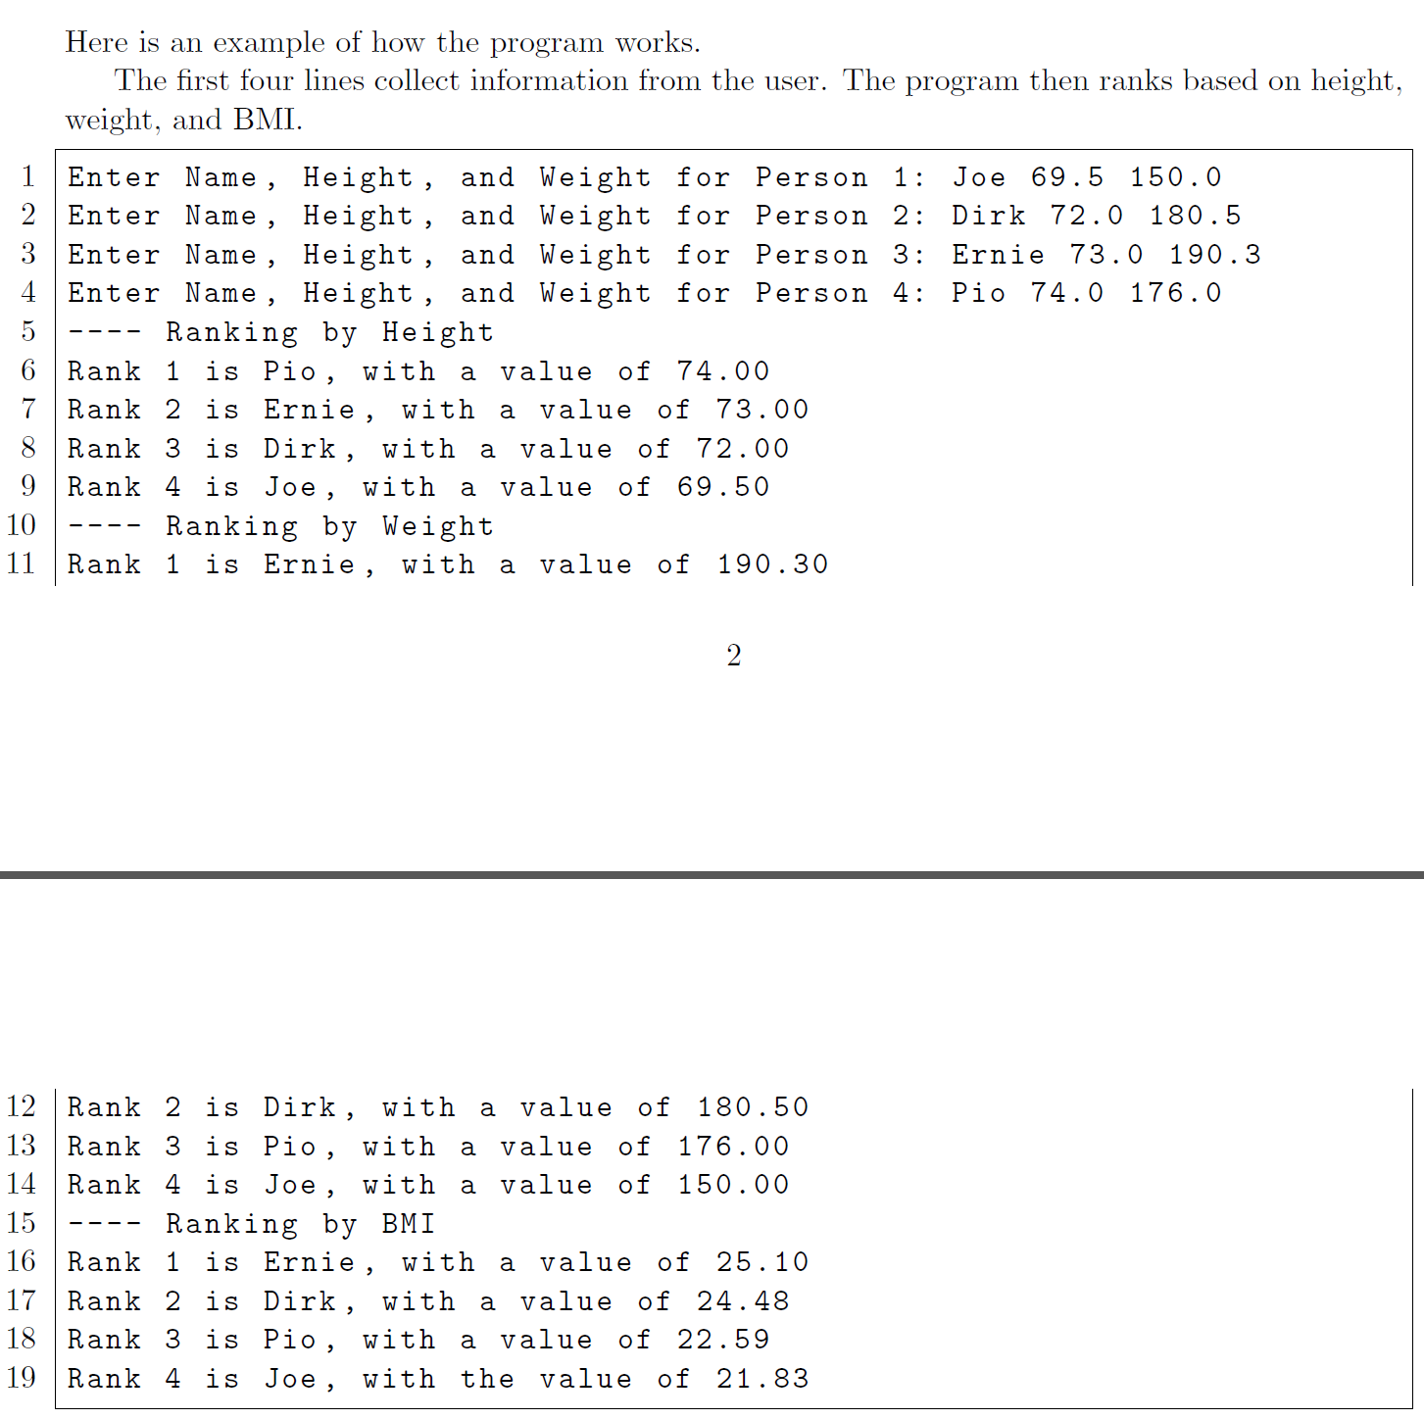
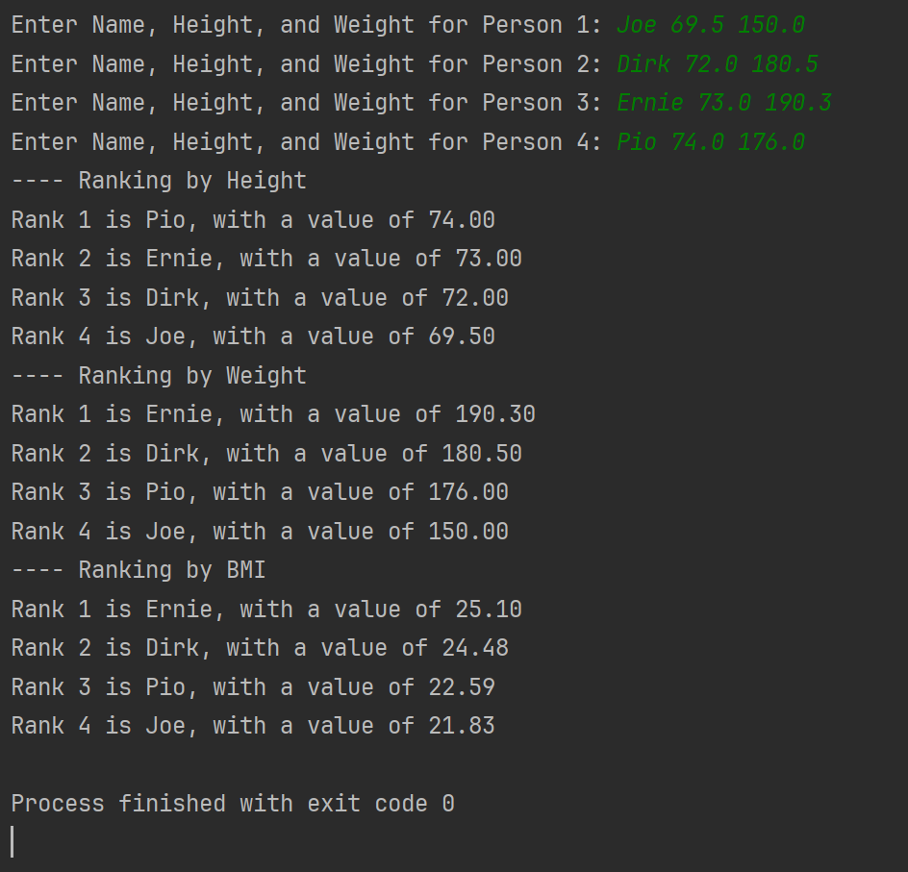
Test Data & Result

Slide 9
TODAY’S LAB HINT
Use the Mathematical Functions in Java

Slide 10
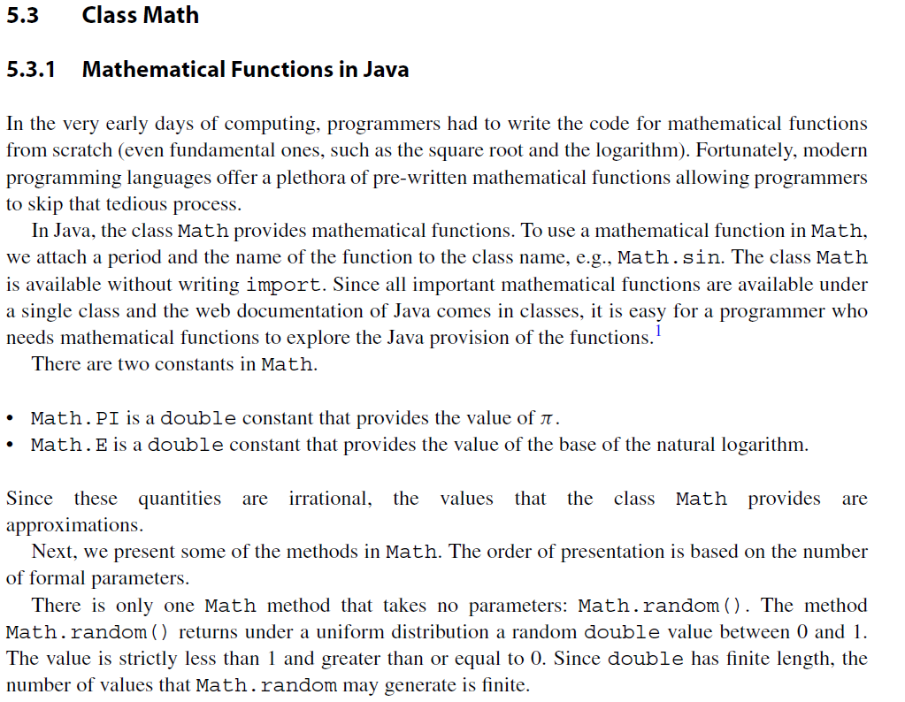
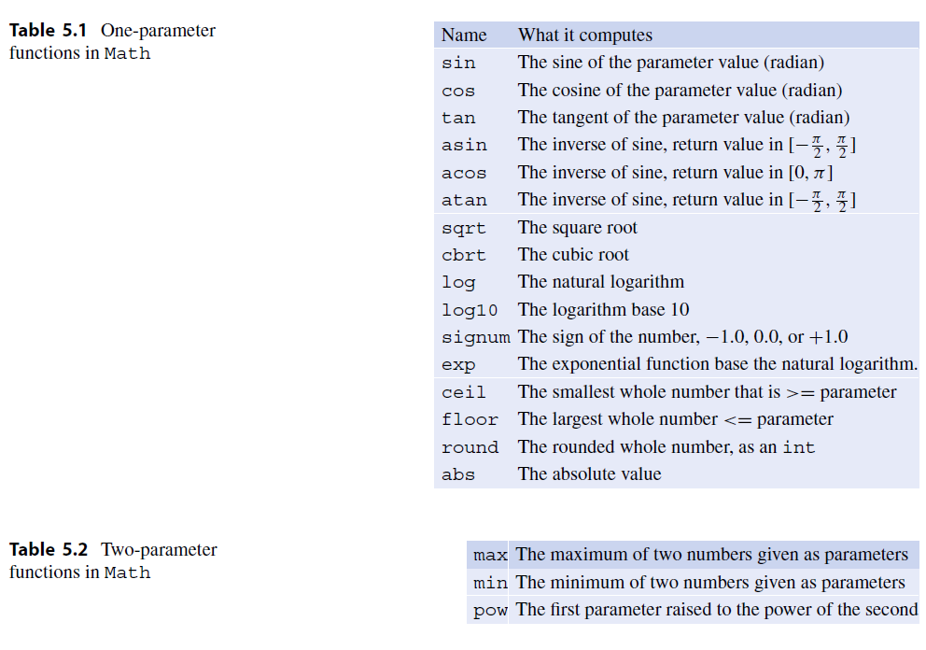
TODAY’S LAB HINT:
Use the Mathematical Functions in Java
From Dr. Ogihara textbook

Slide 11
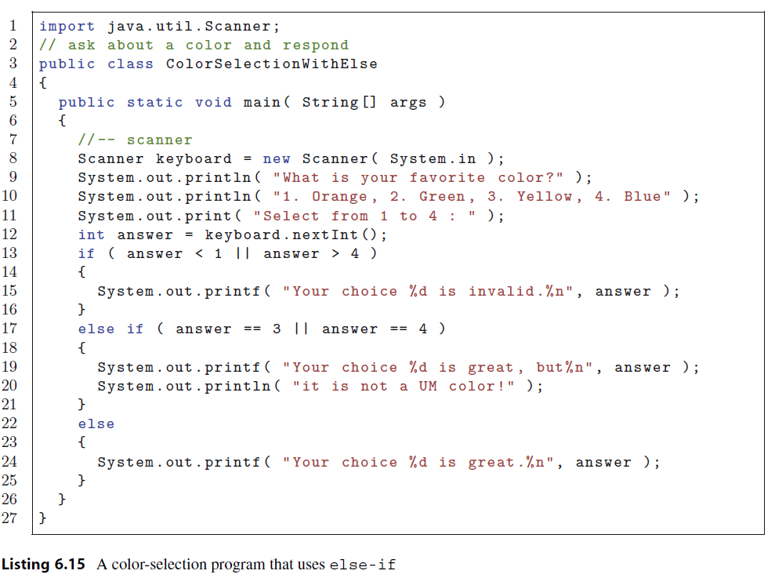
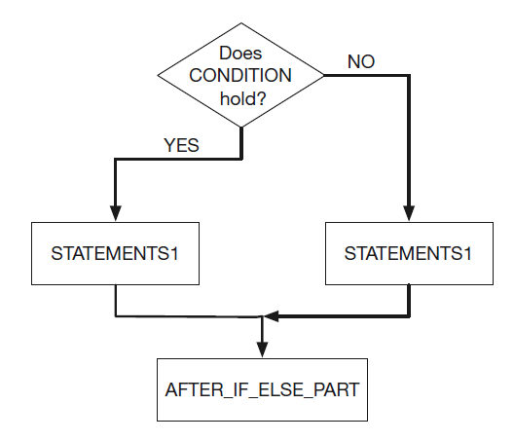
TODAY’S LAB HINT:
Use Java Conditional Statements
From Dr. Ogihara textbook

Slide 12
LAB4 Hint
List of Methods

Slide 13
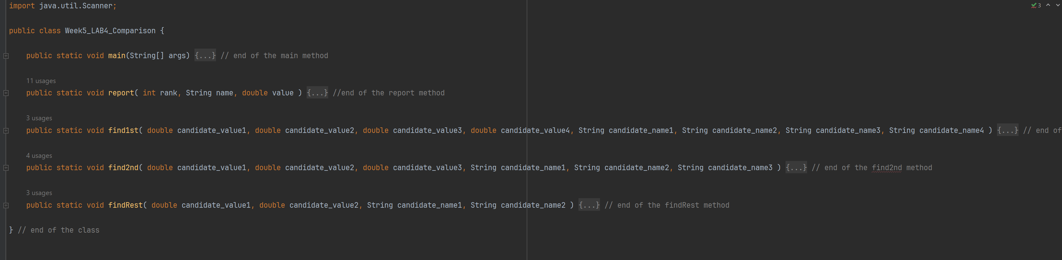
LAB4 Hint: Code Structure

Slide 14
LAB4 Hint: Code Structure
Method parameters
Method parameters
Method parameters
Method parameters

Slide 15
REVIEW & PRACTICE CODING

Slide 16
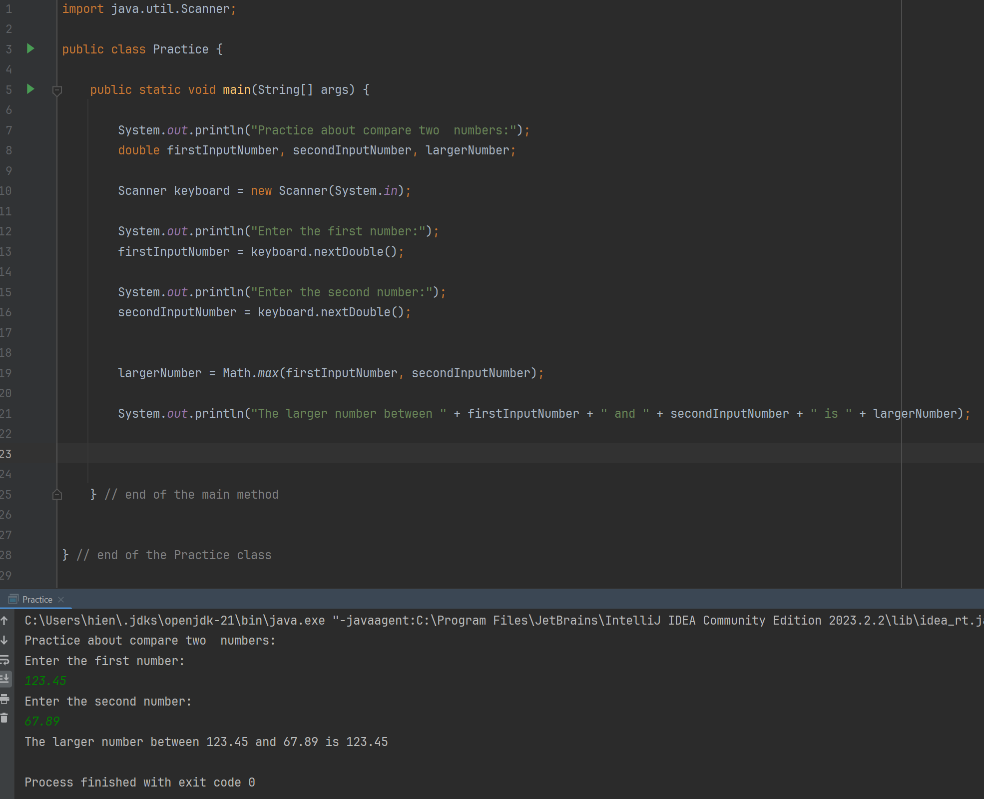

Slide 17
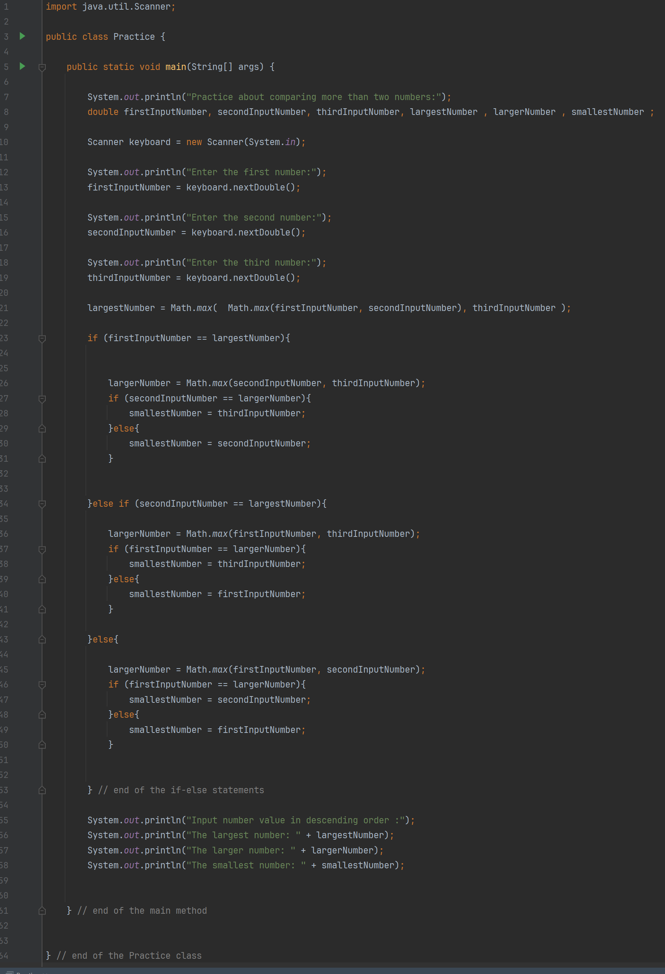
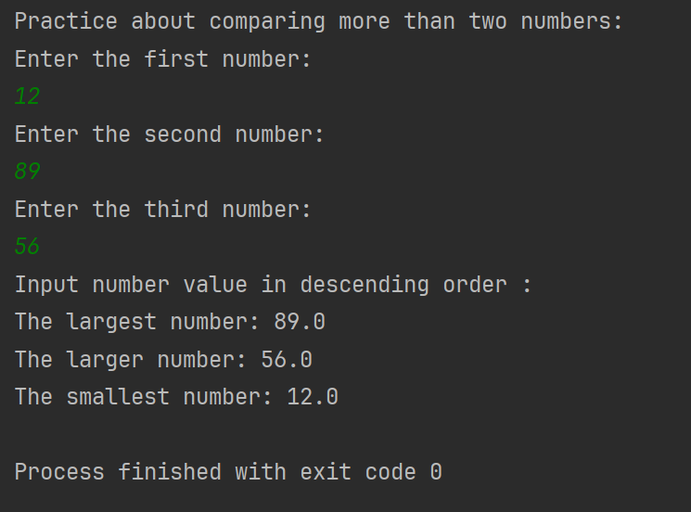
The nested if in this example works for one or two numbers. However, you should use methods/functions to reduce the complexity of the multi-level nested if when you compare many numbers like four or more to rank those numbers in descending or ascending order.
That is exactly the suggestion from the lab 4 instruction that you should follow.

Slide 18
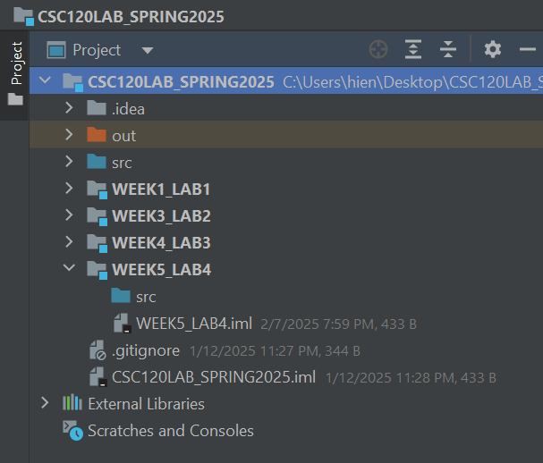
Let’s Begin…

